Slide 1
Digital Fundamentals
Memory and Storage

Slide 2
Basics of Semiconductor Memory

Slide 3
Basics of Semiconductor Memory
Units of binary data
  Bit
  Nibble (4 bits)
  Byte (8 bits)

Slide 4
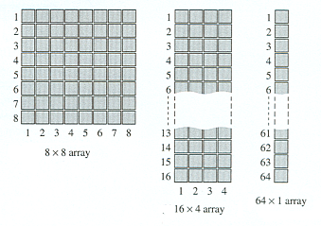
Basics of Semiconductor Memory
A single binary bit is stored in a memory cell
An organized group of cells is called a array

Slide 5
Basics of Semiconductor Memory
Memory cells are organized by columns and rows
A single unit of data occupies one row and a number of columns of cells
  8 columns for a byte of data
  16 columns for a word of data
  32 columns for 32-bit data

Slide 6
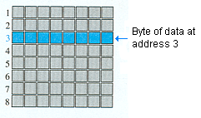
Basics of Semiconductor Memory
The location of a unit of data is called the address
The number of units that can be stored in a memory is the memory’s capacity

Slide 7
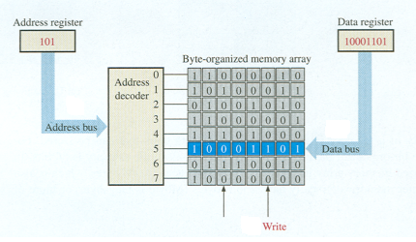
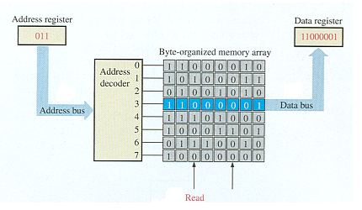
Basics of Semiconductor Memory
Write to memory
Read from memory

Slide 8
Random-Access Memories (RAMs)

Slide 9
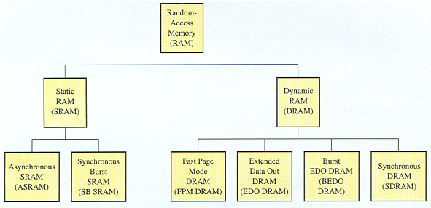
Random-Access Memories (RAMs)

Slide 10
Read-Only Memories (ROM)

Slide 11
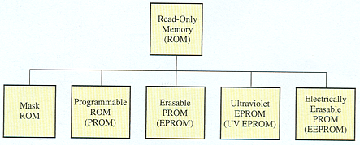
Read-Only Memories (ROM)

Slide 12
Programmable ROMs (PROMs and EPROMs)

Slide 13
Programmable ROMs
Programmable read-only memory (PROM)
Erasable programmable read-only memory (EPROM)

Slide 14
Flash Memories

Slide 15
Flash Memories
High storage capacity
Nonvolatile
In-system read and write
Low power consumption
Relatively fast operation
Cost effective

Slide 16
Memory Expansion

Slide 17
Memory Expansion
Word-length expansion
Word-capacity expansion

Slide 18
Special Types of Memories

Slide 19
Special Types of Memories
First in-first out (FIFO)
Last in-first out (LIFO)

Slide 20
Magnetic and Optical Storage

Slide 21
Magnetic Storage
Hard disk
Floppy disk
Zip™ drive
Tape

Slide 22
Optical Storage
CD-ROM
Write Once/Read Many (WORM)
CD-R
CD-RW
DVD-ROM

